Slide 1
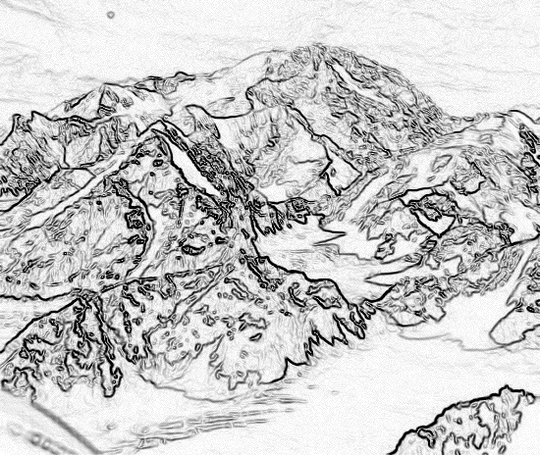
Chapter 2,
Modeling with UML

Slide 2
Overview: modeling with UML
What is modeling
What is UML?
Use case diagrams
Class diagrams
Sequence diagrams
Activity diagrams

Slide 3
What is modeling?
Modeling consists of building an abstraction of reality
Abstractions are simplifications because:
  They ignore irrelevant details and
  They only represent the relevant details
What is relevant or irrelevant depends on the purpose of the model

Slide 4
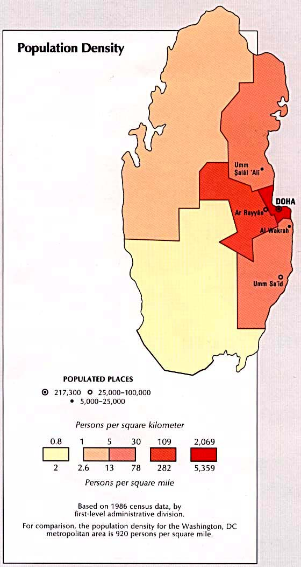
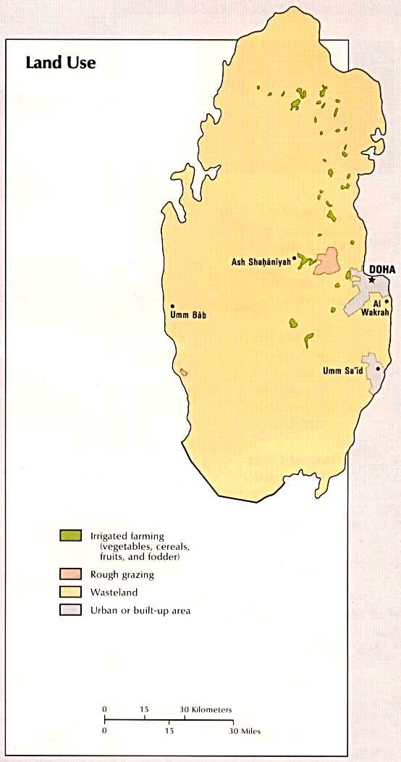
Example: Qatar Maps

Slide 5
Why model software?
Why model software?
Software is getting increasingly more complex
Modeling is a means for dealing with complexity

Slide 6
Systems, Models and Views
A model is an abstraction describing a subset of a system
A view depicts selected aspects of a model
  Simplifies a complex model – subset of a model to make it understandable
A notation is a set of graphical or textual rules for depicting views
Views and models of a single system may overlap each other
Examples:
System: Aircraft
Models: Flight simulator, scale model
Views: electrical wiring, fuel system (views of the scale model)

Slide 7
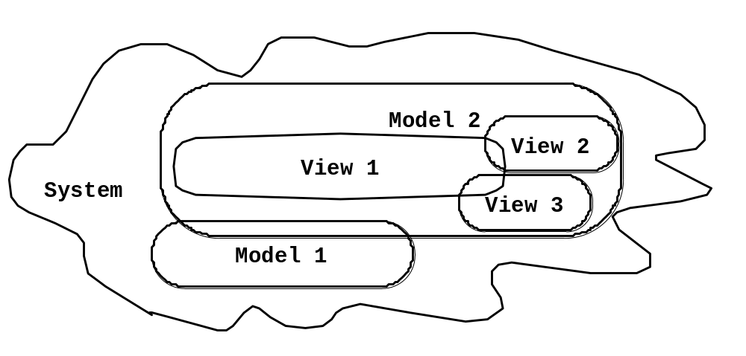
Systems, Models and Views
Scale model
Blueprints
Fuel System
Aircraft
Flight Simulator
Electrical
Wiring

Slide 8
Concepts in software: Data Type and Instance
Data Type
  An abstraction in the context of programming languages
  Has name, members, and valid operations
    Name: int
    Members: 0, -1, 1, 2, -2, . . . (all signed integers between -2³² and 2³²)
    Operations: +, -, *, integer /, mod, . . .
Instance
  Member of a specific type
The type of a variable represents all possible instances the variable can take

Slide 9
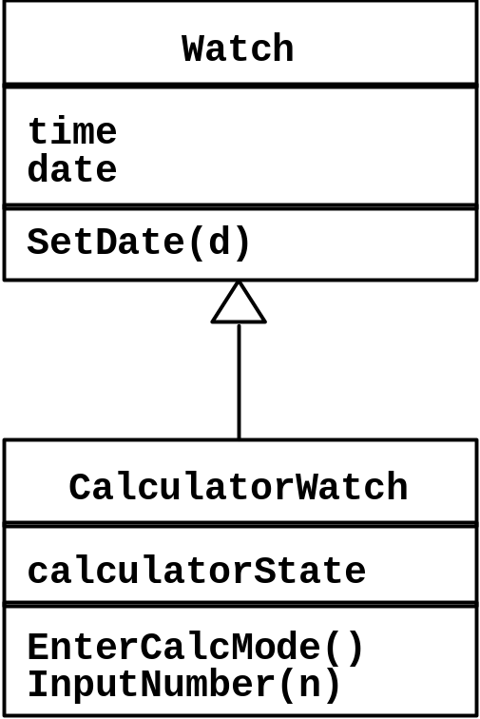
Abstract Data Types & Classes
Abstract data type
  Special type whose implementation is hidden from the rest of the system.
  E.g. set, stack, etc.
Class
  An abstraction in the context of object-oriented languages
  Like an abstract data type, a class encapsulates both state (variables) and behavior (methods)
  Unlike abstract data types, classes can be defined in terms of other classes using inheritance

Slide 10
Objects
Object
  Instance of a class
  Represented by a rectangle with name underlined
  Notice: CalculatorWach1515 is a watch but it is not an instance of Watch
«instanceOf»
simpleWatch1291:Watch
Watch
calculatorWatch1515
«instanceOf»
:CalculatorWatch
CalculatorWatch

Slide 11
Subclasses and Superclasses
Superclass
  Generalization class
Subclass
  Specialization of its superclass
  Refines the superclass by defining new attributes and operations
Abstract class
  Generalized concepts that model shared attributes and operations
  Can not be instantiated
  Name italicized
  E.g.,
Collection
Fruit
LinkedList
HashMap
Orange
Apple

Slide 12
Application and Solution Domain
Application Domain (Requirements Analysis):
  Represents aspects of the user’s problem
    Environment of the system, users, work processes, etc.
Solution Domain (System Design, Object Design):
  The available technologies to build the system

Slide 13
Object-oriented modeling
Application Domain
Solution Domain
Application Domain Model (OO Analysis)
System Model (OO Design)
UML Package
TrafficControl
SummaryDisplay
MapDisplay
TrafficController
FlightPlanDatabase
Aircraft
FlightPlan
Airport
TrafficControl

Slide 14
What is UML?
“The UML is the standard language for specifying, visualizing, constructing, and documenting all the artifacts of a software system.”
An emerging standard notation (by Object Management Group--OMG) for modeling object-oriented software
Unified Modeling Language
  Effective for modeling large, complex software systems
  It can specify systems in an implementation-independent manner
It is simple to learn for most developers, but provides advanced features for expert analysts, designers and architects
  20% of the constructs are used 80% of the time

Slide 15
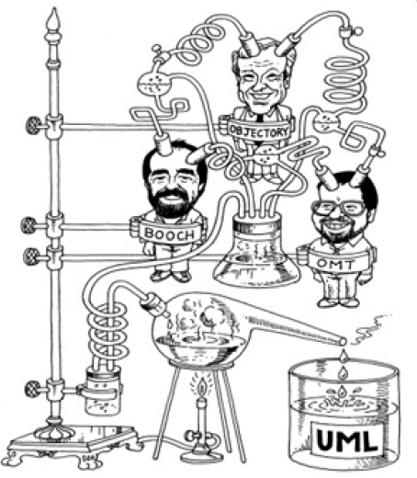
About UML?
Resulted from the convergence of notations from three leading object-oriented methods (early 90’s:
  OMT (James Rumbaugh)
  OOSE (Ivar Jacobson)
  Booch (Grady Booch)
The above three OO gurus joined forces in one company, Rational (now IBM)
  ROSE, Rational Unified Process (RUP), UML
Supported by several CASE tools
  Rational ROSE
  TogetherJ
  Eclipse UML plugin (in our lab)

Slide 16
UML: First Pass
You can model 80% of most problems by using about 20 % UML
We will see these 20%

Slide 17
UML First Pass
Use case Diagrams
  Describe the functional behavior of the system as seen by the user.
Class diagrams
  Describe the static structure of the system: Objects, Attributes, Associations
Sequence diagrams
  Describe the dynamic behavior between actors and the system and between objects of the system
Statechart diagrams
  Describe the dynamic behavior of an individual object (essentially a finite state automaton)
Activity Diagrams
  Model the dynamic behavior of a system, in particular the data flow or control flow through a system (essentially a flowchart)

Slide 18
UML first pass: Use case diagrams
Package
Use case
Watch
Actor
ReadTime
WatchUser
SetTime
WatchRepairPerson
ChangeBattery
Use case diagrams represent the functionality of the system
from user’s point of view

Slide 19
UML first pass: Class diagrams
Class diagrams represent the structure of the system
Association
Class
Multiplicity
Watch
1
1
1
1
2
1
2
1
PushButton
Battery
load
Time
now
state
LCDDisplay
push()
release()
blinkIdx
blinkSeconds()
blinkMinutes()
blinkHours()
stopBlinking()
referesh()
Attribute
Operations

Slide 20
UML first pass: Sequence diagram
Actor
Object
:WatchUser
:Watch
:LCDDisplay
:Time
pressButton1()
blinkHours()
pressButton1()
blinkMinutes()
Message
pressButton2()
incrementMinutes()
refresh()
pressButtons1And2()
commitNewTime()
stopBlinking()
Activation
Lifeline
Sequence diagrams represent the behavior as interactions

Slide 21
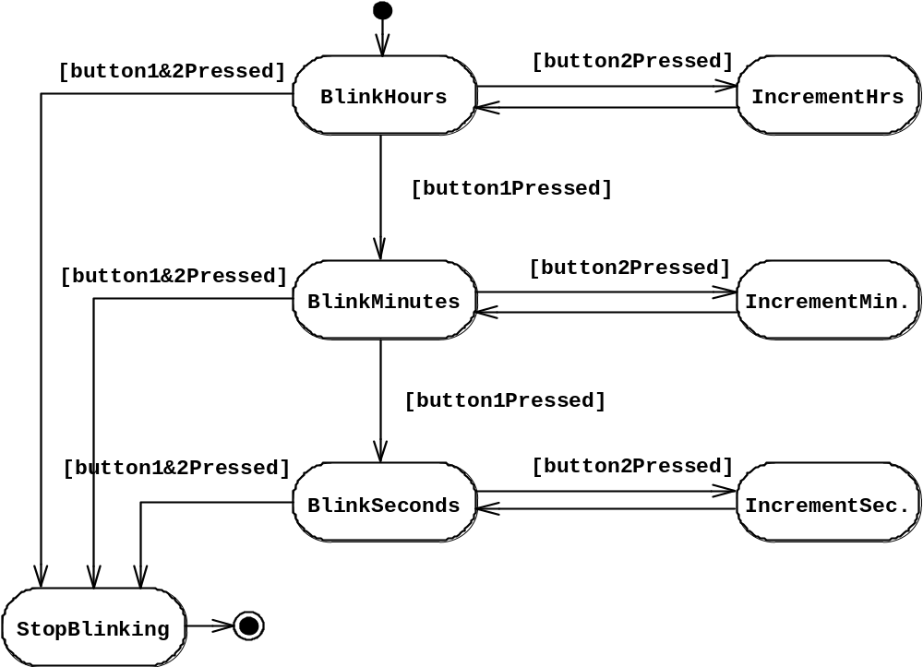
UML first pass: Statechart diagrams for objects with interesting dynamic behavior
State
Event
Initial state
Transition
Final state
Represent behavior as states and transitions

Slide 22
Other UML Notations
UML provide other notations that we will be introduced in subsequent lectures, as needed.
Implementation diagrams
  Component diagrams
  Deployment diagrams
  Introduced in lecture on System Design
Object constraint language
  Introduced in lecture on Object Design

Slide 23
UML Core Conventions
Rectangles are classes or instances
Ovals are functions or use cases
Instances are denoted with an underlined names
  myWatch:SimpleWatch
  Joe:Firefighter
Types are denoted with non underlined names
  SimpleWatch
  Firefighter
Diagrams are graphs
  Nodes are entities
  Arcs are relationships between entities

Slide 24
Use Case Diagrams

Slide 25
What is a Use Case Model?
A view of a system that emphasizes the behavior as it appears to outside users. A use case model partitions system functionality into transactions (‘use cases’) that are meaningful to users (‘actors’).
  Actors represent external entities, E.g.,
    Roles: user, bank teller, customer, system administrator
    Other systems: company DB, Web server, etc.
  Use cases represent a sequence of interaction for a type of functionality
The use case model is the set of all use cases. It is a complete description of the system functionality.

Slide 26
Use Case Diagram
Shows use cases, actor and their relationships
Use case internals are typically specified by textual description
Use case include
  use case diagram
  use case description
Passenger
PurchaseTicket

Slide 27
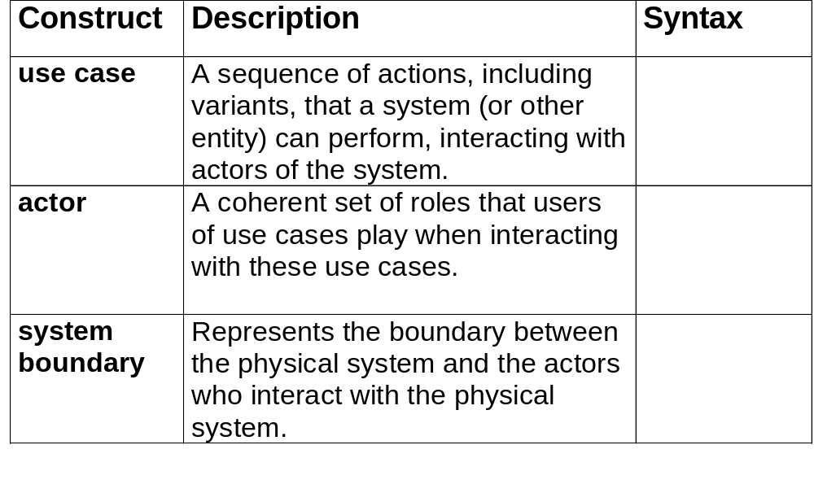
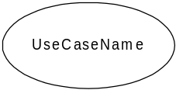
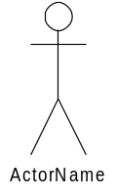

Use Case Diagram Elements

Slide 28
Actors
An actor models an external entity which communicates with the system:
  User
  External system
  Physical environment
An actor has a unique name and an optional description.
Examples:
  Passenger: A person in the train
  GPS satellite: Provides the system with GPS coordinates
Passenger

Slide 29
Use Case
A use case represents a class of functionality provided by the system.
A use case consists of:
Unique name
Participating actors
Entry conditions
Flow of events
Exit conditions
Special requirements
PurchaseTicket

Slide 30
Use Case Description: Example
Name: Purchase ticket
Participating actor: Passenger
Entry condition:
Passenger standing in front of ticket distributor.
Passenger has sufficient money to purchase ticket.
Exit condition:
Passenger has ticket.
Event flow:
1. Passenger selects the number of zones to be traveled.
2. Distributor displays the amount due.
3. Passenger inserts money, of at least the amount due.
4. Distributor returns change.
5. Distributor issues ticket.
Anything missing?
Exceptional cases!

Slide 31
The <<extends>> Relationship
<<extends>> relationships represent exceptional or seldom invoked cases.
The exceptional event flows are factored out of the main event flow for clarity.
Use cases representing exceptional flows can extend more than one use case.
The direction of a <<extends>> relationship is to the extended use case
Passenger
PurchaseTicket
<<extends>>
<<extends>>
<<extends>>
OutOfOrder
<<extends>>
TimeOut
Cancel
NoChange

Slide 32
The <<includes>> Relationship
<<includes>> relationship represents behavior that is factored out of the use case.
<<includes>> behavior is factored out for reuse, not because it is an exception.
The direction of a <<includes>> relationship is to the using use case (unlike <<extends>> relationships).
Passenger
PurchaseMultiCard
PurchaseSingleTicket
<<includes>>
<<includes>>
<<extends>>
CollectMoney
<<extends>>
NoChange
Cancel

Slide 33
The Inheritance Relationship
Used when one use case can specialize another more general one by adding more detail
In the use case description the specialized use case inherits the initiating actor, the entry condition, and the exit condition.
Authenticate
WithPassword
Authenticate
Authenticate
WithCard

Slide 34



Use Case Relationships Summary
Construct | Description | Syntax
Association/ Communication | The participation of an actor in a use case. I.e., instance of an actor and instances of a use case communicate with each other
Generalization/ Inheritance | A taxonomic relationship between a more general use case and a more specific use case
Extend | A relationship from an extension use case to a base use case, specifying how the behavior of the extension use case can be inserted into the base use case
Include | A relationship from an base use case to a inclusion use case, specifying how the behavior of the use case is inserted into the behavior defined for the base use case
<<extend>>
<<include>>

Slide 35
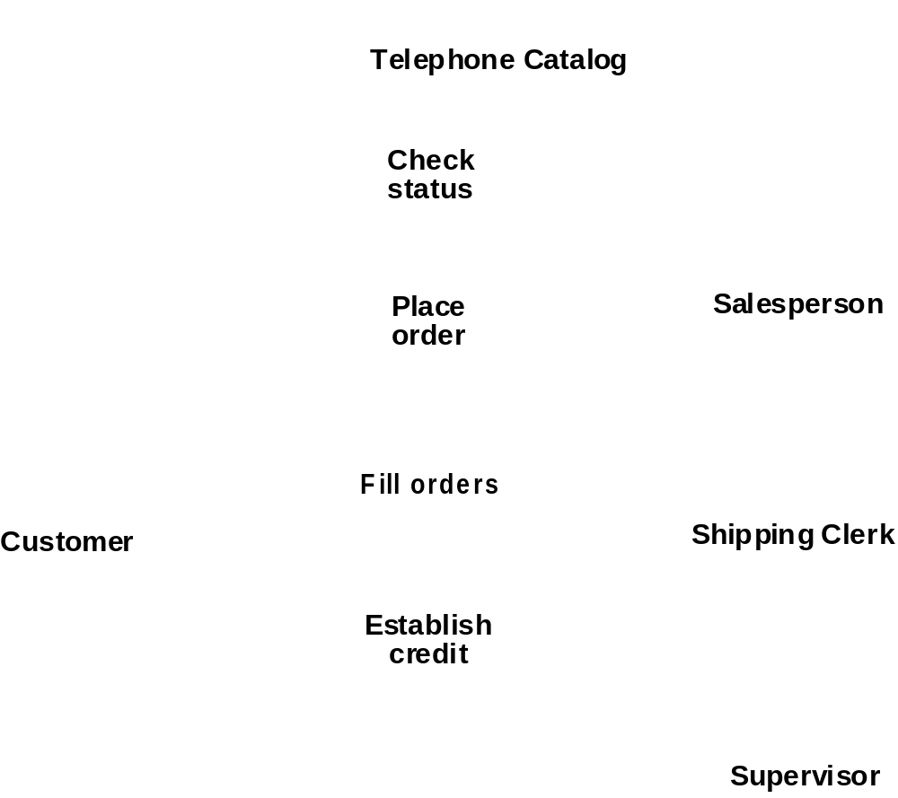
Use Case Diagram Example
Fig. 3-53, UML Notation Guide

Slide 36
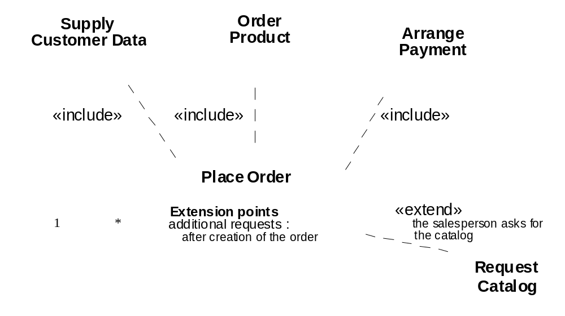
Use Case Relationships Example
Fig. 3-54, UML Notation Guide

Slide 37
Use Case Diagrams: Summary
Use case diagrams represent external behavior
Use case diagrams are useful as an index into the use cases (descriptions)
Use case descriptions provide meat of model, not the use case diagrams.
All use cases need to be described for the model to be useful.
Use cases can be used for
  Model user requirements
  Model test scenarios

Slide 38
Class Diagrams

Slide 39
Class Diagrams
TarifSchedule
Trip
Enumeration getZones()
Price getPrice(Zone)
zone:Zone
Price: Price
*
*
Class diagrams represent the structure of the system.
Used
  during requirements analysis to model problem domain concepts
  during system design to model subsystems and interfaces
  during object design to model classes.

Slide 40
Classes
TarifSchedule
Table zone2price
Enumeration getZones()
Price getPrice(Zone)
Name
TarifSchedule
Attributes
Signature
zone2price
getZones()
getPrice()
Operations
TarifSchedule
A class represent a concept
A class encapsulates state (attributes) and behavior (operations).
Each attribute has a type.
Each operation has a signature.
The class name is the only mandatory information.

Slide 41
Instances
tarif_1974:TarifSchedule
zone2price = {
{‘1’, .20},
{‘2’, .40},
{‘3’, .60}}
An instance represents a phenomenon.
The name of an instance is underlined and can contain the class of the instance.
The attributes are represented with their values.

Slide 42
Associations
TarifSchedule
TripLeg
Enumeration getZones()
Price getPrice(Zone)
*
*
Price
Zone
Associations denote relationships between classes.
The multiplicity of an association end denotes how many objects the source object can legitimately reference.

Slide 43
1-to-1 and 1-to-many Associations
Country
Has-capital
City
name:String
name:String
One-to-one association
Point
Polygon
*
x: Integer
draw()
y: Integer
One-to-many association

Slide 44
Many-to-Many Associations
Lists
*
*
Company
StockExchange
tickerSymbol
Notes:
A stock exchange lists many companies each of them uniquely identified by a ticker symbol used at that stock exchange.
A company can be listed on more than one stock exchange, using the same ticker symbol.
Mercedes Benz is an example for a company listed on more than one stock exchange: Frankfurt and NYSE.
Does it have two different Ticker symbols?
Something not clear here: What happens if the company cannot have the same ticker symbol on two different stock exchanges?

Slide 45
From Problem Statement To Object Model
Pr
oblem Statement: A stock exchange lists many companies. Each
company is uniquely identified by a ticker symbol
Class Diagram:
StockExchange
*
*
Company
Lists
tickerSymbol

Slide 46
From Problem Statement to Code
Pr
oblem Statement
:
A
stock exchange lists many companies.
Each company is identified by a ticker Symbol
Class Diagram:
*
*
Company
StockExchange
Lists
tickerSymbol
Java Code
public class StockExchange
{
private Vector m_Company = new Vector();
};
public class Company
{
public int m_tickerSymbol;
private Vector m_StockExchange = new Vector();
};

Slide 47
Aggregation
An aggregation is a special case of association denoting a “consists of” hierarchy.
The aggregate is the parent class, the components are the children class.
A solid diamond denotes composition, a strong form of aggregation where components cannot exist without the aggregate. (Bill of Material)
Exhaust system
1
0..2
Muffler
Tailpipe
diameter
diameter
TicketMachine
3
ZoneButton

Slide 48
Qualifiers
Without qualification
1
*
File
Directory
filename
With qualification
1
0…1
Directory
filename
File
Qualifiers can be used to reduce the multiplicity of an association.

Slide 49
Inheritance
Button
CancelButton
ZoneButton
The children classes inherit the attributes and operations of the parent class.
Inheritance simplifies the model by eliminating redundancy.

Slide 50
Object Modeling in Practice: Class Identification
Foo
Amount
CustomerId
Deposit()
Withdraw()
GetBalance()
Class Identification: Name of Class, Attributes and Methods

Slide 51


Object Modeling in Practice:
Encourage Brainstorming
“Dada”
Foo
Amount
Amount
CustomerId
CustomerId
Deposit()
Deposit()
Withdraw()
Withdraw()
GetBalance()
GetBalance()
Account
Amount
CustomerId
Deposit()
Naming is important!
Is Foo the right name?
Withdraw()
GetBalance()

Slide 52
Object Modeling in Practice ctd
Account
Amount
Customer
AccountId
Bank
CustomerId
Name
Name
Deposit()
CustomerId
Withdraw()
GetBalance()
1) Find New Objects
2) Iterate on Names, Attributes and Methods

Slide 53
Object Modeling in Practice: A Banking System
Account
Amount
*
Customer
AccountId
Has
Bank
CustomerId
AccountId
Name
Name
Deposit()
CustomerId
Withdraw()
GetBalance()
1) Find New Objects
2) Iterate on Names, Attributes and Methods
3) Find Associations between Objects
4) Label the assocations
5) Determine the multiplicity of the assocations

Slide 54
Practice Object Modeling: Iterate, Categorize!
Account
Bank
Customer
*
Amount
*
Name
Has
Name
AccountId
CustomerId
AccountId
Deposit()
Withdraw()
GetBalance()
CustomerId()
Savings
Account
Checking
Account
Mortgage
Account
Withdraw()
Withdraw()
Withdraw()

Slide 55
Packages
A package is a UML mechanism for organizing elements into groups (usually not an application domain concept)
Packages are the basic grouping construct with which you may organize UML models to increase their readability.
A complex system can be decomposed into subsystems, where each subsystem is modeled as a package
DispatcherInterface
Notification
IncidentManagement

Slide 56
UML sequence diagrams
Used during requirements analysis
  To refine use case descriptions
  to find additional objects (“participating objects”)
Used during system design
  to refine subsystem interfaces
Classes are represented by columns
Messages are represented by arrows
Activations are represented by narrow rectangles
Lifelines are represented by dashed lines
Passenger
TicketMachine
selectZone()
insertCoins()
pickupChange()
pickUpTicket()

Slide 57
Nested messages
Passenger
ZoneButton
TarifSchedule
Display
selectZone()
lookupPrice(selection)
price
Dataflow
displayPrice(price)
…to be continued...
The source of an arrow indicates the activation which sent the message
An activation is as long as all nested activations
Horizontal dashed arrows indicate data flow
Vertical dashed lines indicate lifelines

Slide 58
Iteration & condition
…continued from previous slide...
Passenger
ChangeProcessor
CoinIdentifier
Display
CoinDrop
*
insertChange(coin)
lookupCoin(coin)
Iteration
price
displayPrice(owedAmount)
Condition
[owedAmount<0] returnChange(-owedAmount)
…to be continued...
Iteration is denoted by a * preceding the message name
Condition is denoted by boolean expression in [ ] before the message name

Slide 59
Creation and destruction
…continued from previous slide...
Passenger
ChangeProcessor
Creation
createTicket(selection)
Ticket
print()
free()
Destruction
Creation is denoted by a message arrow pointing to the object.
Destruction is denoted by an X mark at the end of the destruction activation.
In garbage collection environments, destruction can be used to denote the end of the useful life of an object.

Slide 60
Sequence Diagram Summary
UML sequence diagram represent behavior in terms of interactions.
Useful to find missing objects.
Time consuming to build but worth the investment.
Complement the class diagrams (which represent structure).

Slide 61
State Chart Diagrams
Initial state
State
Event
Transition
Final state
Represent behavior as states and transitions

Slide 62
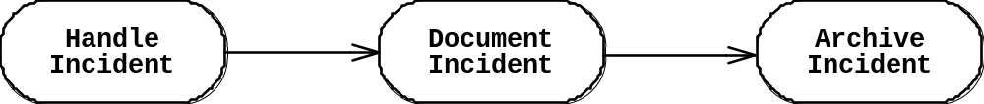
Activity Diagrams
An activity diagram shows flow control within a system
An activity diagram is a special case of a state chart diagram in which states are activities (“functions”)
Two types of states:
  Action state:
    Cannot be decomposed any further
    Happens “instantaneously” with respect to the level of abstraction used in the model
  Activity state:
    Can be decomposed further
    The activity is modeled by another activity diagram

Slide 63
Statechart Diagram vs. Activity Diagram
Statechart Diagram for Incident (similar to Mealy Automaton)
(State: Attribute or Collection of Attributes of object of type Incident)
Event causes
State transition
Active
Inactive
Closed
Archived
Incident-
Handled
Incident-
Documented
Incident-
Archived
Activity Diagram for Incident (similar to Moore
(State: Operation or Collection of Operations)
Completion of activity
causes state transition
Triggerless
Transition

Slide 64
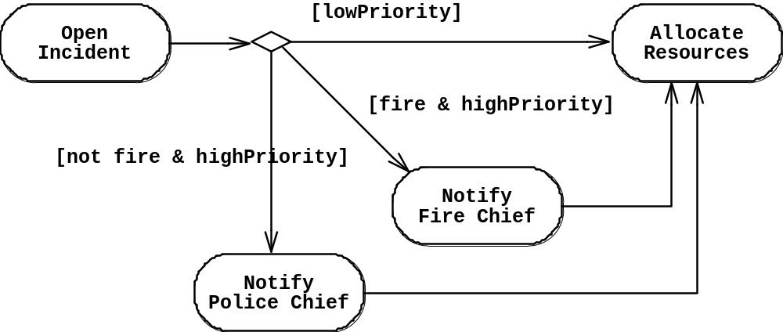
Activity Diagram: Modeling Decisions

Slide 65
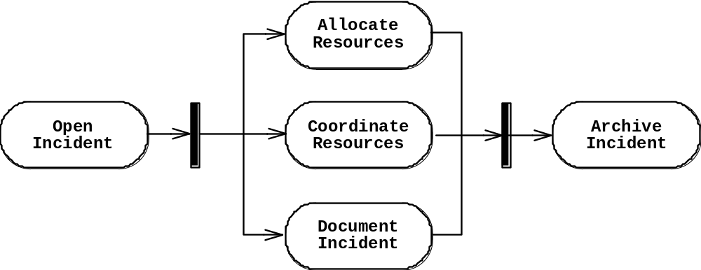
Activity Diagrams: Modeling Concurrency
Synchronization of multiple activities
Splitting the flow of control into multiple threads
Splitting
Synchronization

Slide 66
Activity Diagrams: Swimlanes
Actions may be grouped into swimlanes to denote the object or subsystem that implements the actions.
Allocate
Dispatcher
Resources
Open
Coordinate
Archive
Incident
Resources
Incident
FieldOfficer
Document
Incident

Slide 67
What should be done first? Coding or Modeling?
It all depends….
Forward Engineering:
  Creation of code from a model
  Greenfield projects
Reverse Engineering:
  Creation of a model from code
  Interface or reengineering projects
Roundtrip Engineering:
  Move constantly between forward and reverse engineering
  Useful when requirements, technology and schedule are changing frequently

Slide 68
UML Summary
UML provides a wide variety of notations for representing many aspects of software development
  Powerful, but complex language
  Can be misused to generate unreadable models
  Can be misunderstood when using too many exotic features
For now we concentrate on a few notations:
  Functional model: Use case diagram
  Object model: class diagram
  Dynamic model: sequence diagrams, statechart and activity diagrams

Slide 69
Additional Slides

Slide 70
Models for Plato’s and Aristotle’s Views of Reality
Plato
Aristotle
Material reality is a second-class subordinate type of reality.
The first-class type is a “form” Forms lie behind every thing or in the world. Forms can be abstract nouns like “beauty” or “mammal” or concrete nouns like “tree” or “horse”.
There is an important difference between the world of forms and particulars. Forms are nonmaterial, particulars are material. Forms are permanent and changeless. Particulars are changing.
Forms can be acquired intellectually through a “dialectic” process that moves toward the highest understanding of reality through the interaction of questions and answers.
Aristotle accepted the reality of Forms as nonmaterial entities.
However, he could not accept Plato’s idea, that these Forms were not real.
Instead of two separate worlds, one for Forms and one for Particulars, Aristotle had only one world, a world of particular things.
Particular things according to Aristotle have a certain permance about them, even while they are subject to change: A tree changes colors without ceasing to be a tree. A horse grows in size without ceasing to be a horse.
What is the root of this permancence? It is the thing’s internal form, which minds detect, when they penetrate beyond the thing’s changing attributes. So for Aristotle, reality is thus made up of particular things that are each composed of form antdn matter..
Using UML, we can illustrate Platon’s and Aristotle’s viewpoints very easily
and see their differences as well
Notes:
lato’s model of reality (UML class diagram).
Reality consists of many particular things and many forms. Note, that forms are not abstract classes that need to be instantiated. Forms such as beauty really exist independent from a particular, that is they can be instantiated by themself.
Aristotle’s model of reality:
Reality consists of many particular things called substances.
Each substance is composed of form and matter.
Beauty is real but it does not exist on its own, it is always part of a really existing thing called the substance.

Slide 71
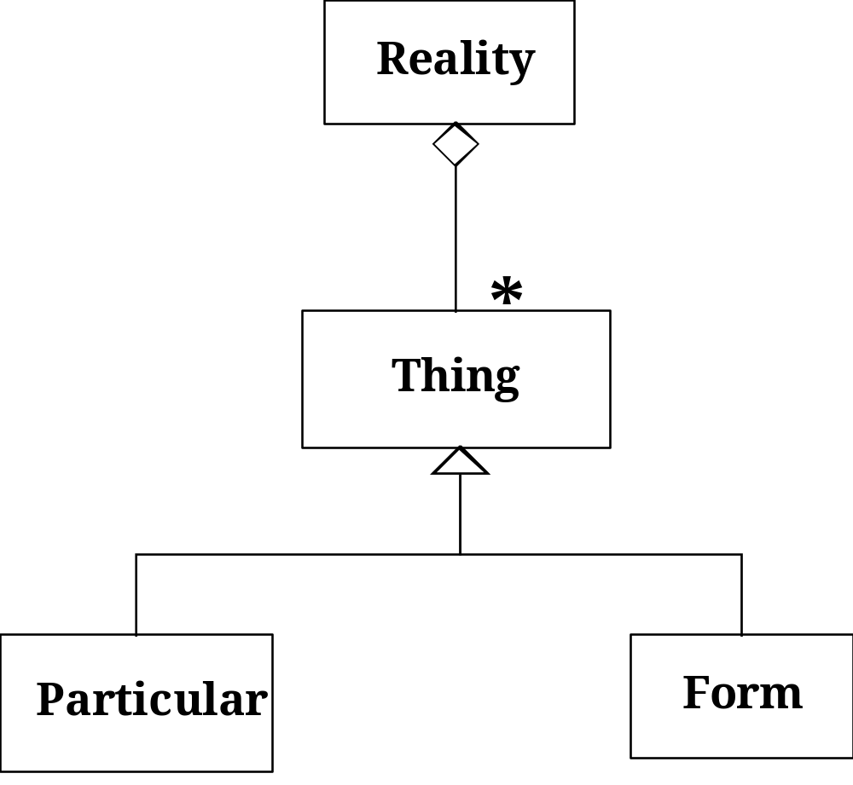
Model for Plato’s View of Reality
Plato
Material reality is a second-class subordinate type of reality.
The first-class type is a “form” Forms lie behind every thing or in the world. Forms can be abstract nouns like “beauty” or “mammal” or concrete nouns like “tree” or “horse”.
There is an important difference between the world of forms and particulars. Forms are nonmaterial, particulars are material. Forms are permanent and changeless. Particulars are changing.
Forms can be acquired intellectually through a “dialectic” process that moves toward the highest understanding of reality through the interaction of questions and answers.
Notes:
lato’s model of reality (UML class diagram).
Reality consists of many particular things and many forms. Note, that forms are not abstract classes that need to be instantiated. Forms such as beauty really exist independent from a particular, that is they can be instantiated by themself.
Aristotle’s model of reality:
Reality consists of many particular things called substances.
Each substance is composed of form and matter.
Beauty is real but it does not exist on its own, it is always part of a really existing thing called the substance.

Slide 72
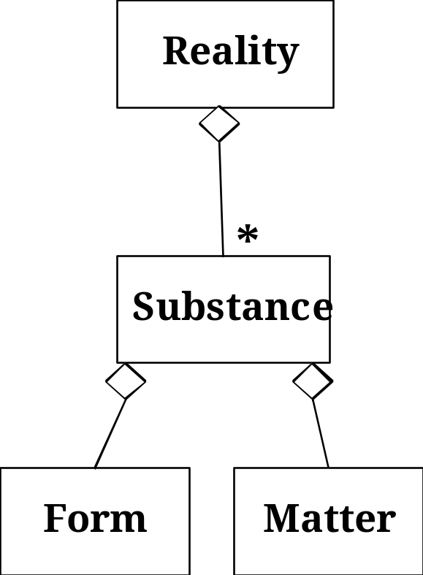
Model Aristotle’s Views of Reality
Aristotle
Aristotle accepted the reality of Forms as nonmaterial entities.
However, he could not accept Plato’s idea, that these Forms were not real.
Instead of two separate worlds, one for Forms and one for Particulars, Aristotle had only one world, a world of particular things.
Particular things according to Aristotle have a certain permance about them, even while they are subject to change: A tree changes colors without ceasing to be a tree. A horse grows in size without ceasing to be a horse.
What is the root of this permancence? It is the thing’s internal form, which minds detect, when they penetrate beyond the thing’s changing attributes. So for Aristotle, reality is thus made up of particular things that are each composed of form antdn matter..
Notes:
lato’s model of reality (UML class diagram).
Reality consists of many particular things and many forms. Note, that forms are not abstract classes that need to be instantiated. Forms such as beauty really exist independent from a particular, that is they can be instantiated by themself.
Aristotle’s model of reality:
Reality consists of many particular things called substances.
Each substance is composed of form and matter.
Beauty is real but it does not exist on its own, it is always part of a really existing thing called the substance.

Slide 73
Comparison of Plato’s and Aristotle’s Views
Plato
Aristotle
Notes:
lato’s model of reality (UML class diagram).
Reality consists of many particular things and many forms. Note, that forms are not abstract classes that need to be instantiated. Forms such as beauty really exist independent from a particular, that is they can be instantiated by themself.
Aristotle’s model of reality:
Reality consists of many particular things called substances.
Each substance is composed of form and matter.
Beauty is real but it does not exist on its own, it is always part of a really existing thing called the substance.

